Slide 1
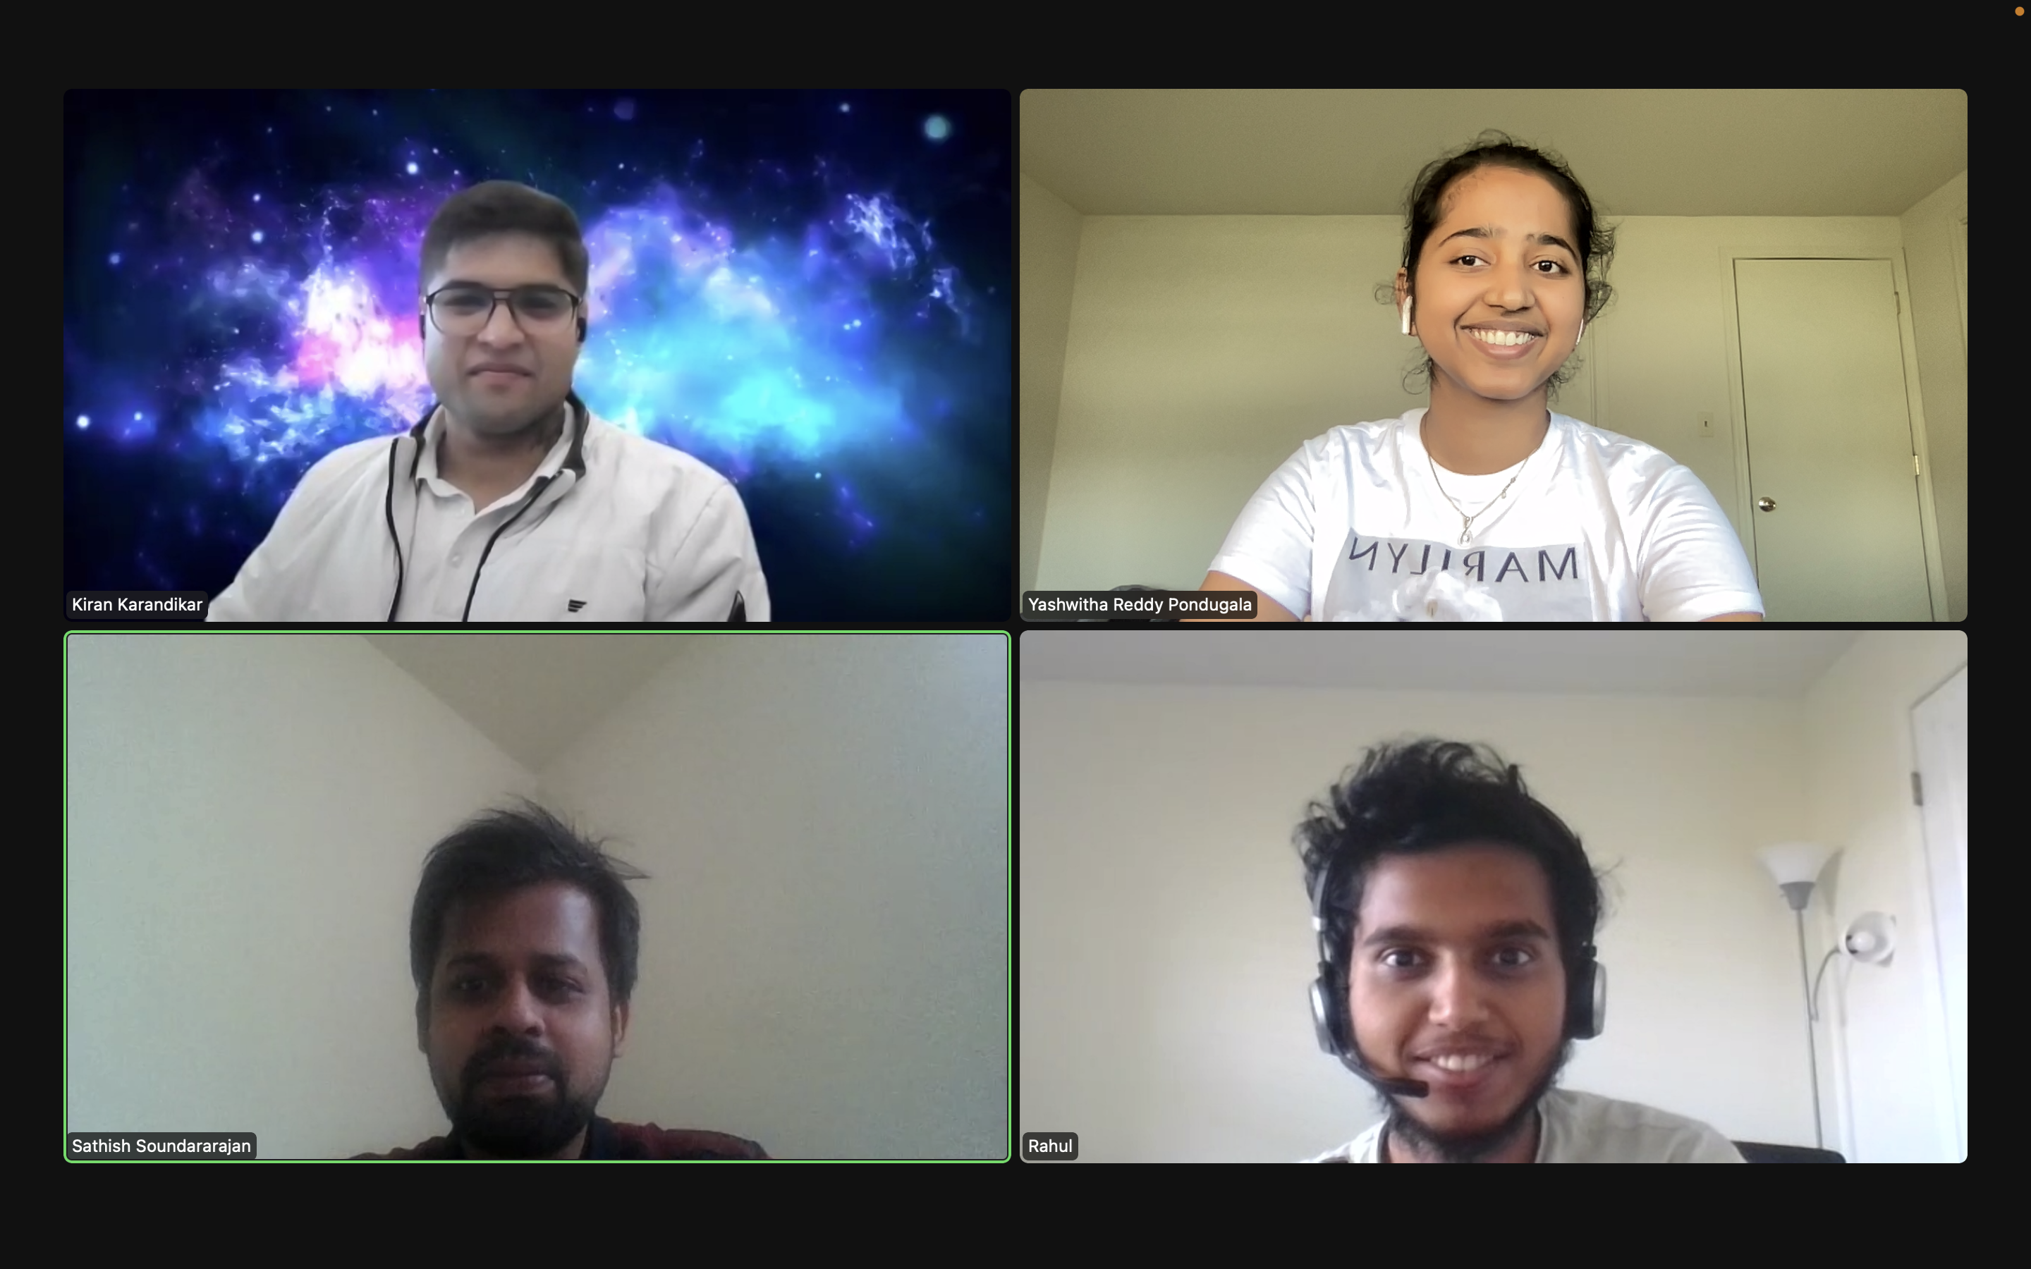
Home Credit Default Risk Prediction
Phase 1- Group 02
Kiran Karandikar
Sathish Soundararajan
Yashwitha Reddy Pondugala
Rahul Gomathi Sankarakrishnan

Slide 2
Contents
Project Description
Data Preparation
EDA
Feature Engineering
Hyperparameter Tuning
Baseline model
Scores

Slide 3
Project Description:
Our project is on the Home Credit Default Risk (HCDR) which is basically used to determine if a person is likely to payback the loan taken or not.
Building a model using various machine learning techniques used to estimate how competent each applicant is of repaying a loan, with the goal of only approving loans for those who are likely to repay them can be an effective method.

Slide 4
Data Preparation
After the datasets were loaded we looked at the missing values in each dataset and the shape of the dataset.
So, the correlation matrices for positive correlations and negative correlations which show the relationship between data is shown.

Slide 5
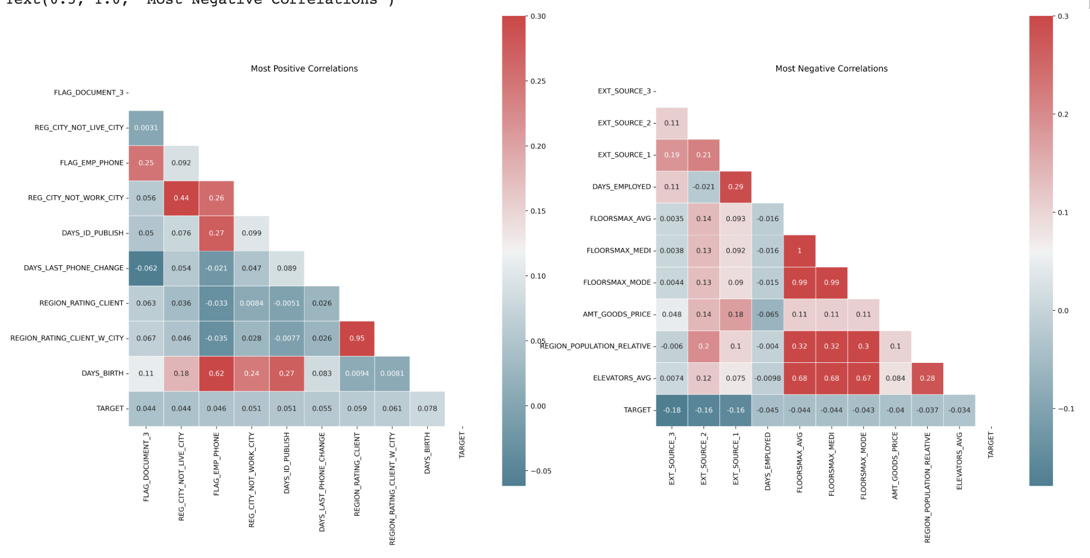

Slide 6
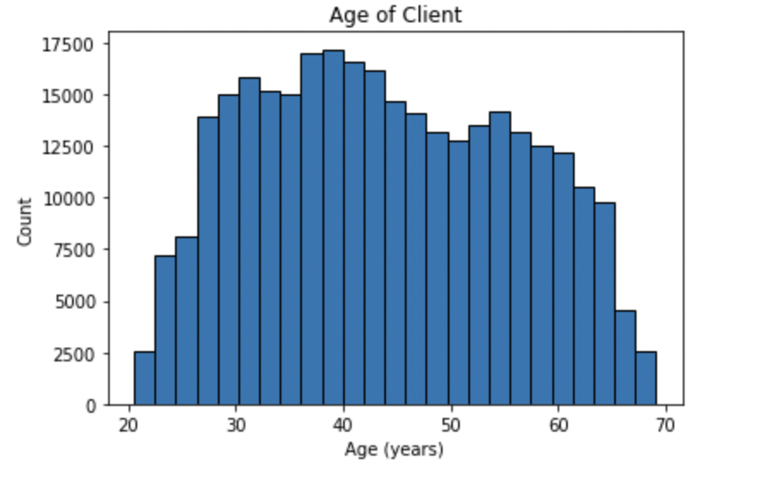
Exploratory Data Analysis
Few EDA techniques are done on the given datasets. This has been helpful to find out the missing value for each attribute and in deciding important attributes
We have first looked at the relation between age and count of applications.
Some of the graphs plotted are shown below.

Slide 7
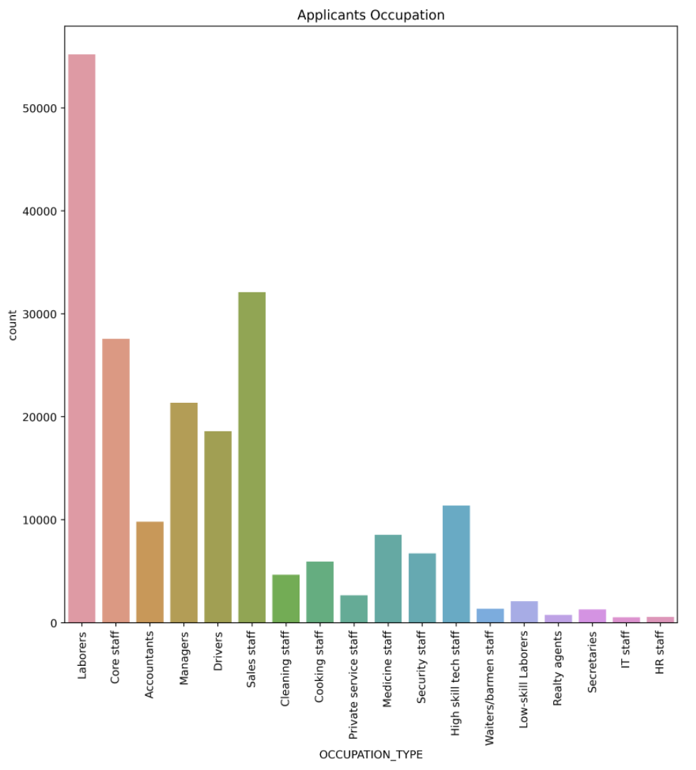
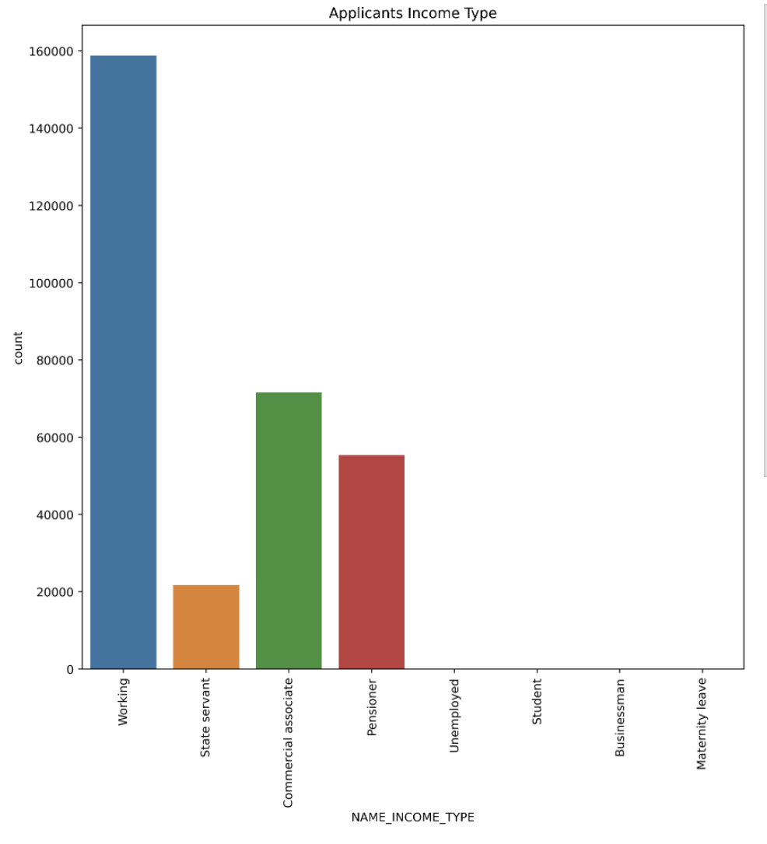
Then we saw the relationship between count and applicant occupation, income type, housing type, gender and family status

Slide 8
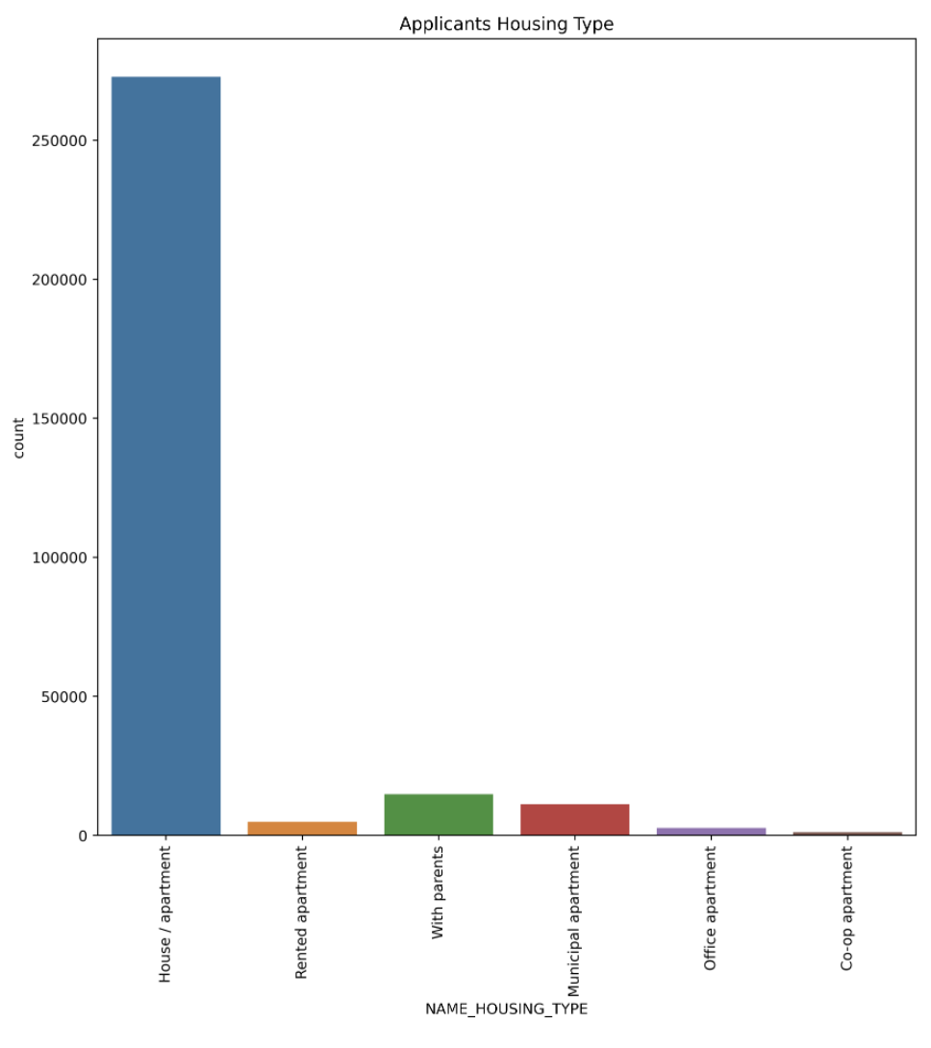
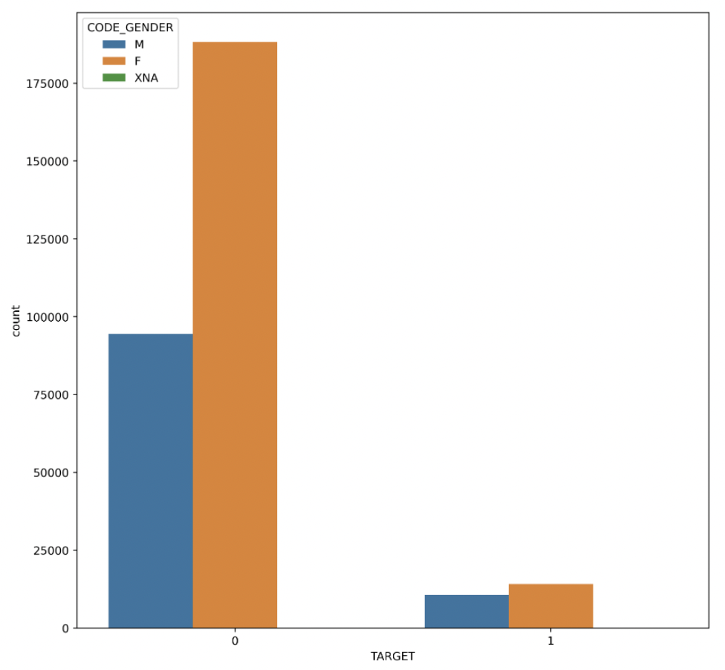

Slide 9
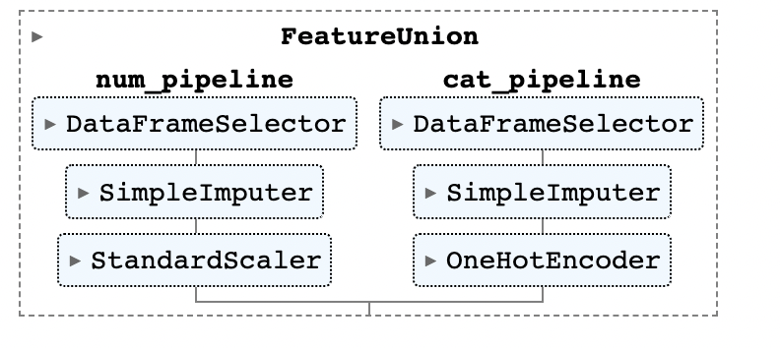
Feature Engineering & Hyperparameter Tuning
We one-hot encoded all the category features for Feature Engineering.
Pipelines for all secondary tables are created
The aggregated data is merged in main table using pipeline
Numerical pipeline and categorical pipeline are specified as shown.

Slide 10
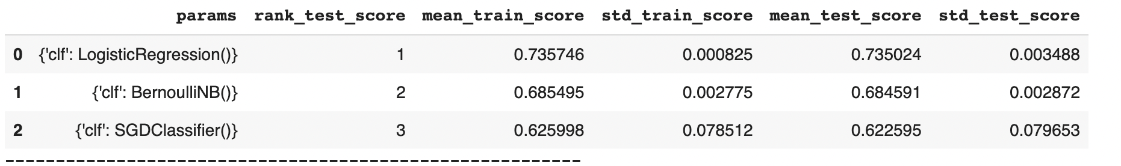
Results from pipeline:

Slide 11
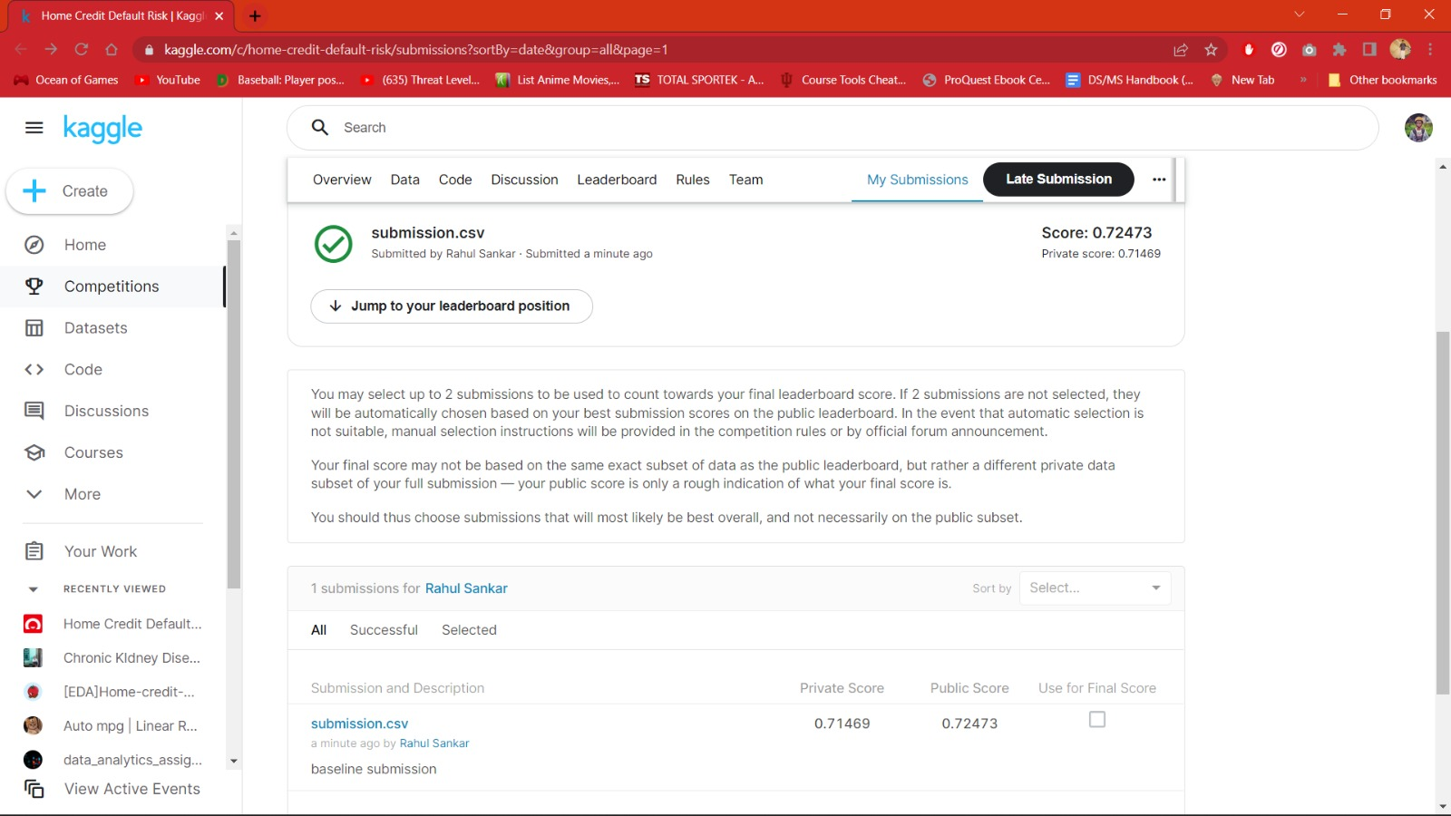
Kaggle Submission:

Slide 12
Conclusion:
In this phase we have tried and gained some deeper knowledge regarding the datasets and the relationships between the datasets.
The process of EDA has been helpful to know more about the relationships between various features.
We built a baseline model where some of the features are used after being preprocessed through the pipeline.
Plans for Phase 2:
In phase two we are going to focus a bit more on the feature engineering
Like engineering RFM features(Recency, Frequency, and Monetary value)
And also building a multi-layer perception (MLP) model in PyTorch.

